Slide 1
Ratings prediction

Slide 2
1
Introduction
2
Problem statement
CONTENTS
3
Understanding of Dataset
4
Tools used

Slide 3
5
EDA
6
Data Preprocessing
CONTENTS
7
Visualization
8
Model building

Slide 4
1
Introduction

Slide 5
Introduction
We have a client who has a website where people write different reviews for technical products. Now they are adding a new feature to their website i.e. The reviewer will have to add stars(rating) as well with the review.
The rating is out 5 stars and it only has 5 options available 1 star, 2 stars, 3 stars, 4 stars, 5 stars. Now they want to predict ratings for the reviews which were written in the past and they dont have a rating.
So, we are working on building an application which can predict the rating by seeing the review.
In data collection phase we have scrapped as many reviews and ratings as possible by using websites like flipkart and amazon
In data modelling we have used algo’s like SVC,Logistic Regression,K-neighbors classifiers,Bernouli,Decision Tree Classifier

Slide 6
2
Problem Statement

Slide 7
Problem Statement
We have to develop an application which will predict the ratings by getting reviews has input.
The main challenge here is to scrape all the reviews and ratings for training our model.
then, we will start validating the test model that we have built by using algo’s

Slide 8
3
Understanding Data

Slide 9
Understanding dataset
Data contains 37392 entries each having 3 variables, Ratings,Review,Long review
Data contains No Null values
We are using wordcloud to analyze the possibility of negetive,positive as well has neutral sentiments
Data has to be cleaned first by using unneccesary spaces,punctuations,repeating words by using stop words,lemmatization,stemming.

Slide 10
4
Tools used

Slide 11
Tools used
Tools Used
Python(Jupyter)
Numpy
Pandas
Sklearn
Matplotlib
Seaborn
Classification Models
Ensembling Technique
GridSearch CV(HyperParaMeter Tuning)

Slide 12
5
Data Preparation

Slide 13
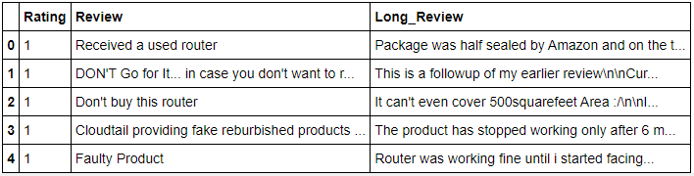
Data Preparation
With the help of Pandas Library We will upload our data to Jupyter Notebook.
Once our data is uploaded with the help of predefined method (i.e. read_csv) we can read data for further processing.
We have two type of variables in the data:-
Dependent Variable
Independent Variable

Slide 14
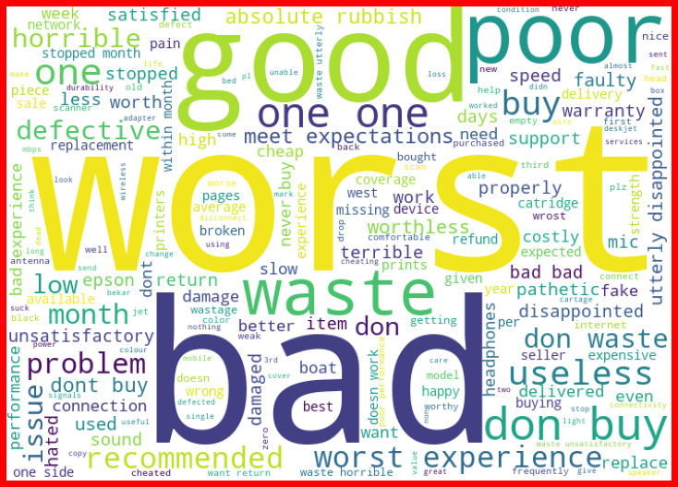
1 star rating

Slide 15
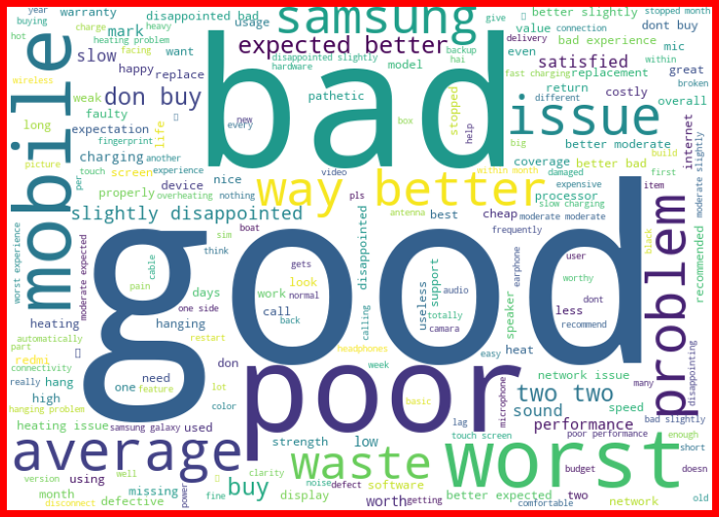
2 star rating

Slide 16
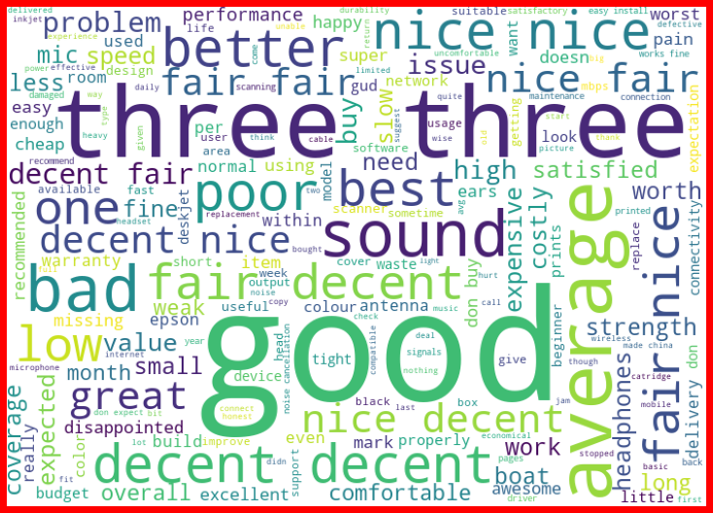
3 star rating

Slide 17
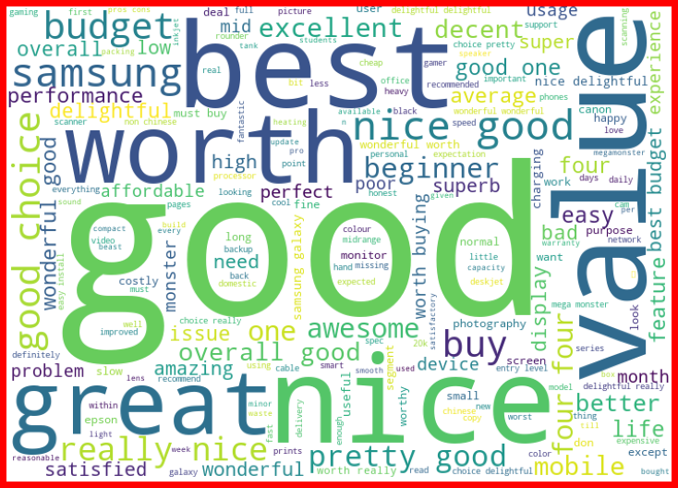
4 star rating

Slide 18
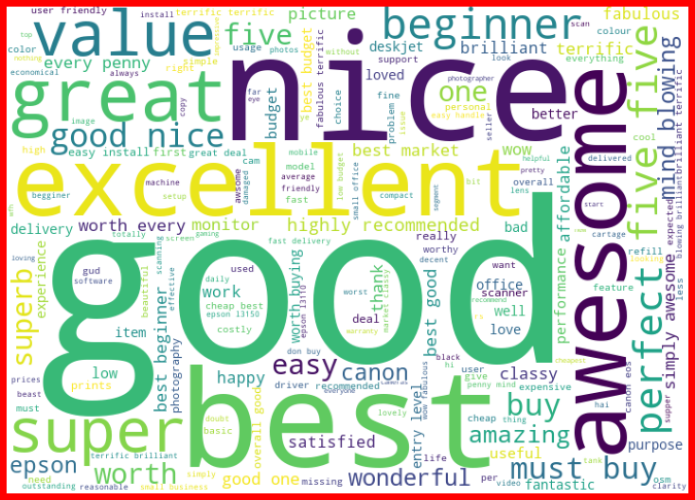
5 star rating

Slide 19
6
Visualization

Slide 20
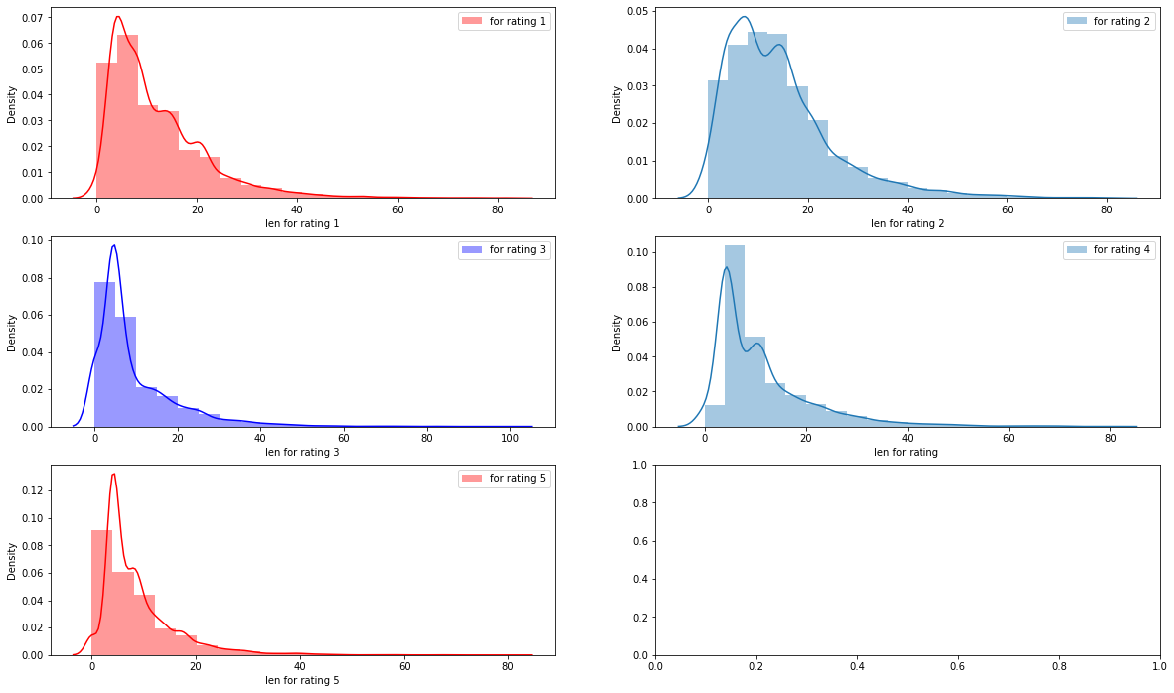
Visualization

Slide 21
7
Data Preprocessing

Slide 22
Data Preprocessing
The Complete data is divided in the ration of 70:30 for train and test respectively.
There is no null value present in the dataset and almost all the columns type is objective so we don’t need to check for outliers.
Once our data is ready, we’ll do further processing.
I have not dropped any column since the model accuracy is good.

Slide 23
Data Preprocessing
The Complete data is divided in the ration of 70:30 for train and test respectively.
There is no null value present in the dataset and almost all the columns type is objective so we don’t need to check for outliers.
Once our data is ready, we’ll do further processing.
I have not dropped any column since the model accuracy is good.

Slide 24

Data Preprocessing
Evaluation Matrices:
Accuracy - it determines how often a model predicts default and non default correctly.
Precision-it calculates whenever our models predicts it is default how often it is correct.
Recall- Recall regulate the actual default that the model is actually predict.
Precision Recall Curve - PRC will display the tradeoff between Precision and Recall threshold.
Cross Validations:
K Fold cross validations , K = 5

Slide 25
8
Model Building

Slide 26
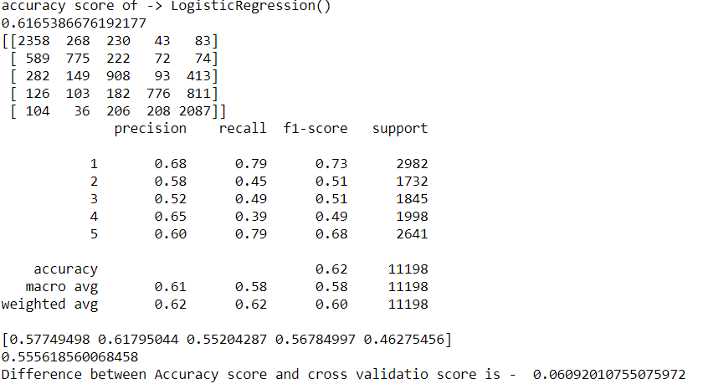
Model Building- Logistic Regression

Slide 27
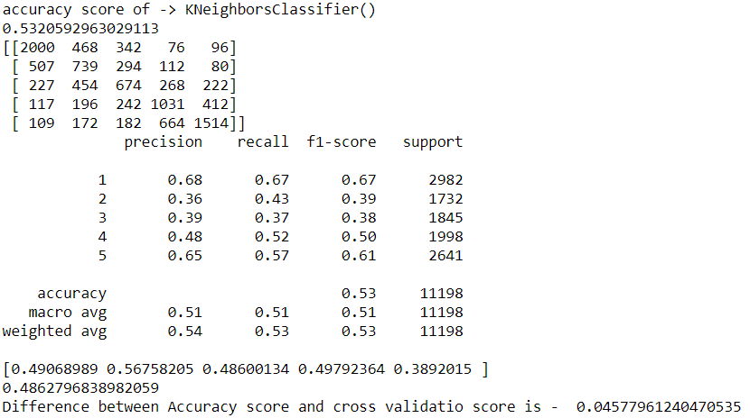
Model building- K nearest neighbor classifier

Slide 28
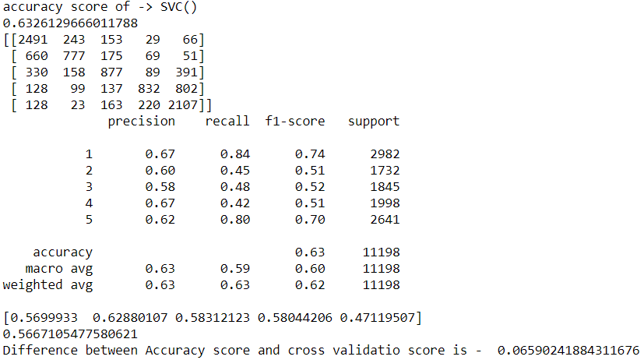
Model building- SVC

Slide 29
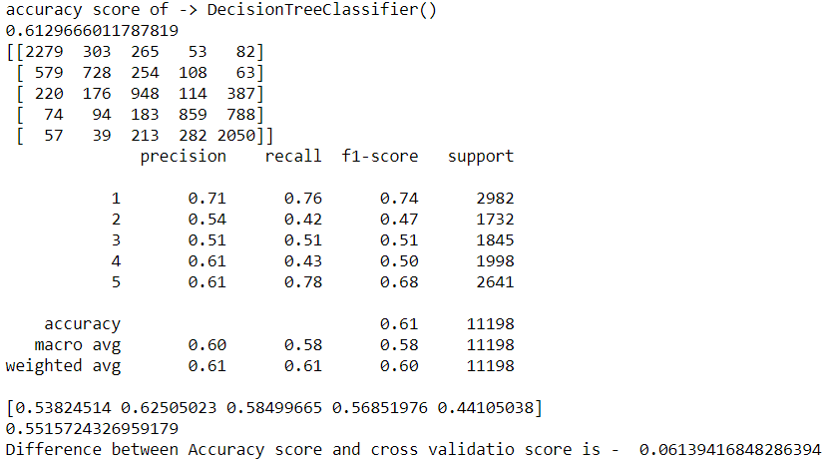
Model building- Decision Tree Classifier

Slide 30
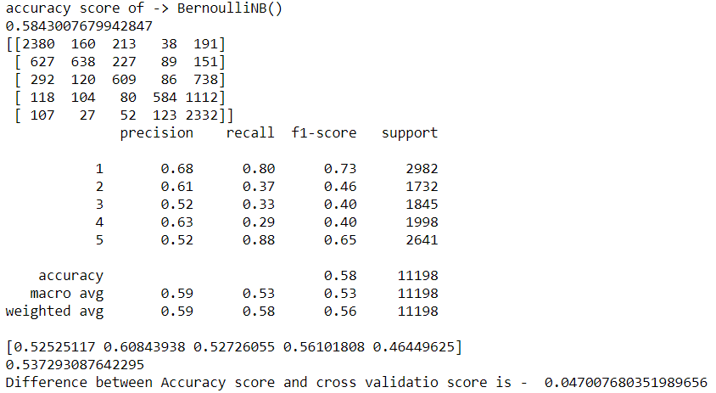
Model building- Bernoulli NB

Slide 31
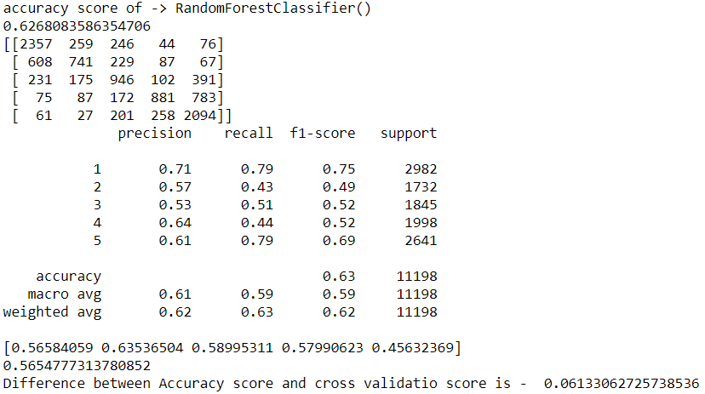
Model building- Random Forest Classifier

Slide 32
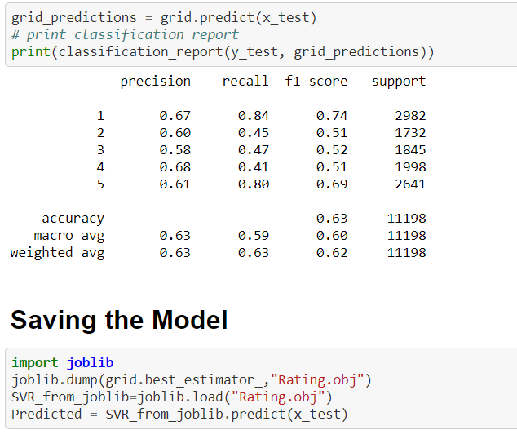
Validating the model
From the details on the above solutions it is clearly understandable that we are getting best result with the help of SVC, so we save this model with the help of joblib Library.

Slide 33
Conclusion
As we know data is increasing in every second in our day today life. So more the data better the model.
If we make this dataset for sentiment analysis, we choose ratings 3 or more as our threshold for being helpful reviews or good or positive reviews and below 3 we choose reviews is not helpful or bad reviews or negative reviews.
For example: two people give their reviews on a product as ‘a nice product. But their ratings are ‘4’ and ‘5’ respectively. This is where the model fails to predict whether to choose rating ‘4’ or’5’.
Due to increase in data in our daily basics, this model can be used to predict ratings of reviews.
It might be a good tool for online shopping sites and manufacturer companies who may predict their customers ratings so that they can make their investment according to the demand of customers, which might help them to save time and earn more profits.

Slide 34
Thanks！

